Slide 1
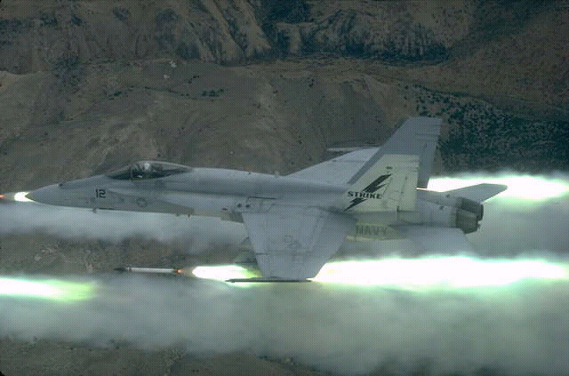
PRINCIPLES OF HIGH SPEED FLIGHT 1

Slide 2
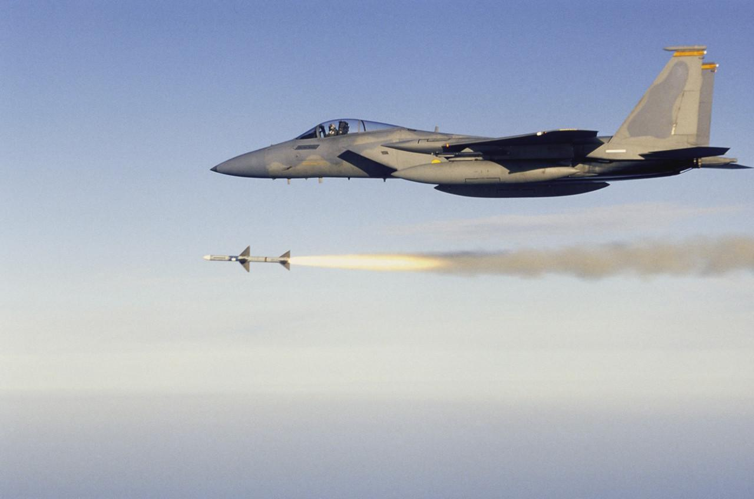
OBJECTIVES
Understand relative airflow compressibility issues as they become apparent at EAS values above 250 kts;
Understand the processes and effects of shockwave formation under varying flight circumstances;
Induce an awareness of the differences between subsonic, transonic and supersonic flight; also with particular
regard to lift and drag coefficients; and various definitions;
Produce a general awareness of the fundamental differences between subsonic and supersonic flow;
Understand design strategies which mitigate compressibility effects;
Understand the effects of high altitude on handling and stability; also with particular regard to associated limitations.

Slide 3
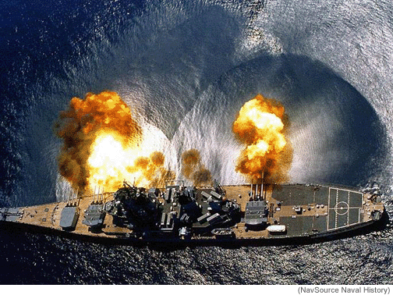
SUPERSONIC SHOCKWAVES
MANY PROJECTILES EXIT WEAPONS WITH
SUPERSONIC MUZZLE VELOCITY
THE RESULTING SHOCK WAVES (VISIBLE IN THIS SLIDE
ON THE WATER SURFACE), PRODUCE AN AUDIBLE SONIC
BOOM, LOUD FOR LARGE CALIBRE PROJECTILES, BUT
MORE LIKE A “CRACK” FOR THOSE OF SMALLER CALIBRE
FOR THE SAME UNDERLYING REASON, AIRCRAFT OPERATING AT TAS VALUES HIGHER THAN 250 KTS BEGIN TO EXHIBIT SYMPTOMS OF COMPRESSIBLE AIRFLOW; LEADING TO SHOCKWAVE FORMATION

Slide 4
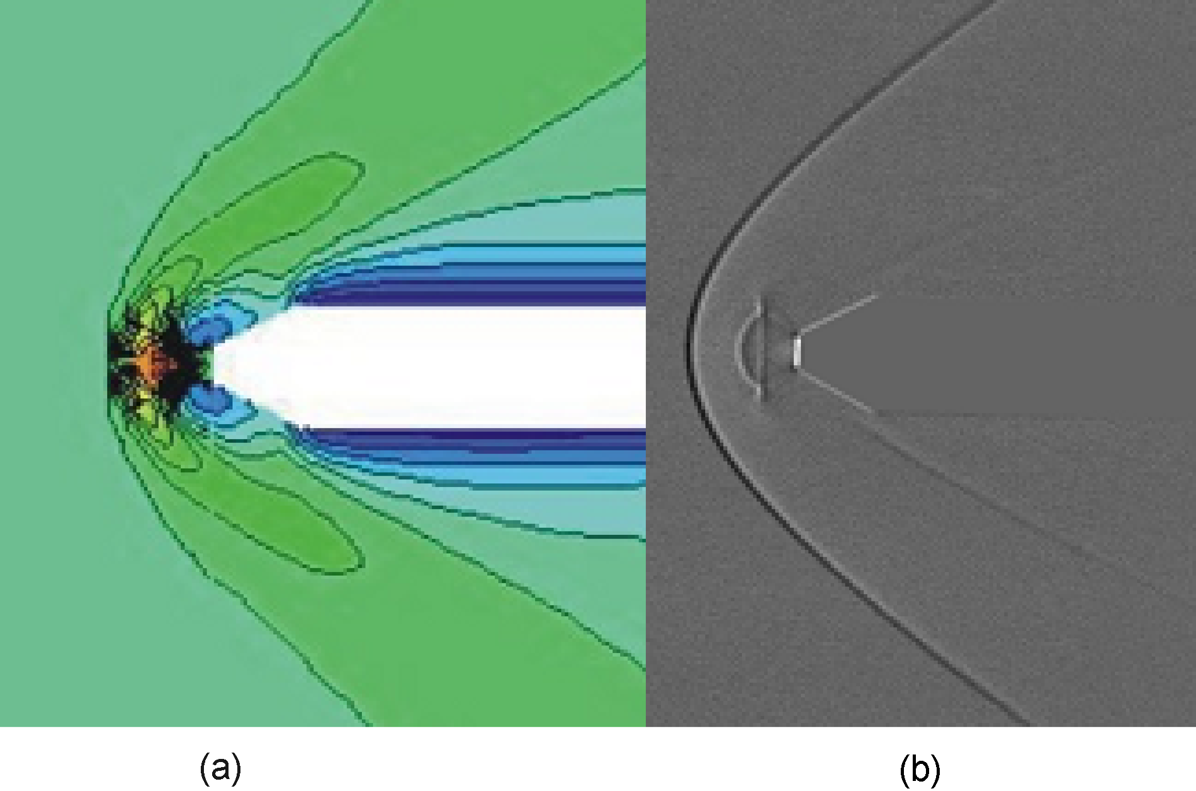
COMPRESSIBLE AIRFLOW
COMPRESSIBILITY EFFECTS LEAD TO DENSITY INCREASE
E.G at MSL:
TAS 150 kts - 4.5%
TAS 300 kts - 8%
TAS 450 kts - 17%
TAS 600 kts - 42%
Stagnation Region
Aerofoil Leading Edge
Relative airflow is always compressible
but this only becomes noticeable at mid
to high subsonic speeds.

Slide 5
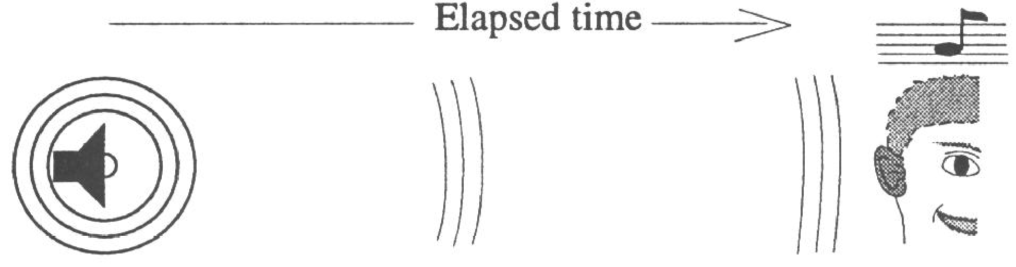
SOUND WAVES ARE PRESSURE WAVES TRANSMITTED AT AN AUDIBLE FREQUENCY
A suitable visual analogy is that of a stone dropped into water.
A pressure wave transmitted from a stationary single point source is spherical.
The three dimensional pressure wave is transmitted at local sonic speed.

Slide 6
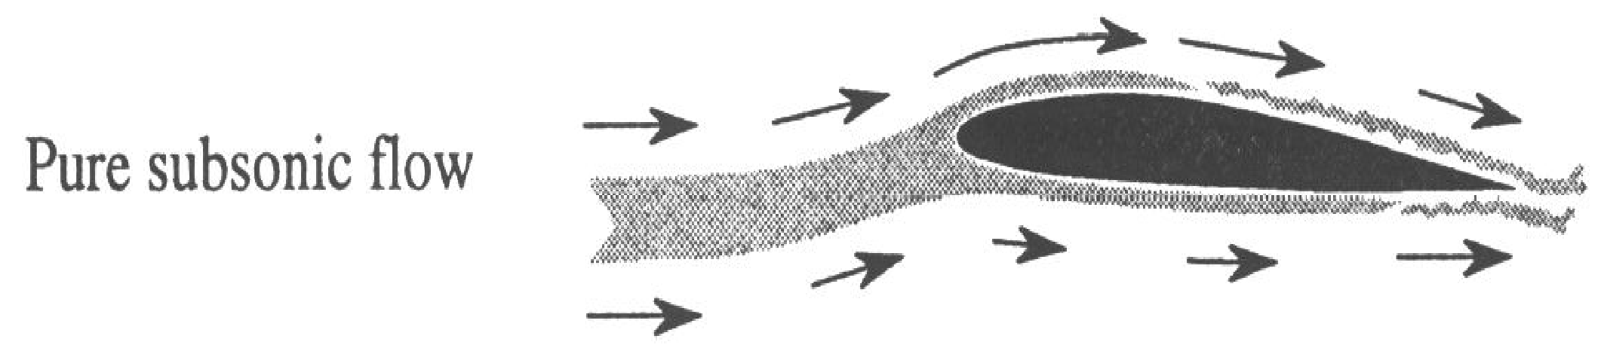
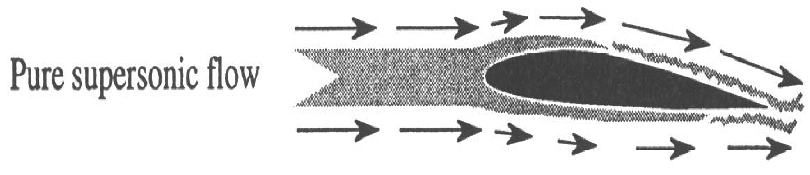
FlOW PATTERNS
Mach Free Stream (MFS) is the Mach number of the relative airflow remote
from the aircraft , and unaffected by its presence.
MFS = Aircraft TAS (V) divided by local sonic speed (LSS).
SUBSONIC AIRFLOW “SENSES” THE PRESSURE WAVE TRANSITTED AHEAD OF THE AIRCRAFT AT SONIC VELOCITY AND ADJUSTS –
DENSITY REMAINS CONSTANT.
SUPERSONIC FLOW OCCURS WHEN THE AIRCRAFT IS FLYING FASTER THAN SONIC VELOCITY - NO ADJUSTMENT OCCURS. DENSITY CHANGES.

Slide 7
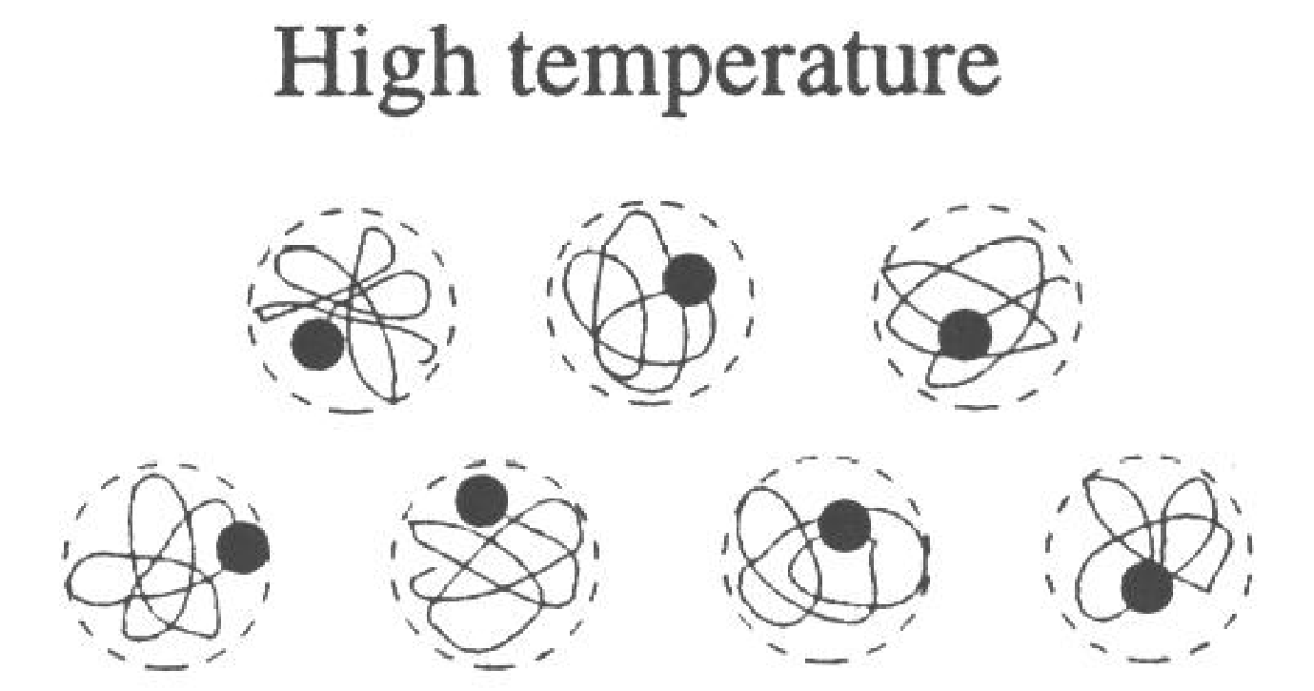
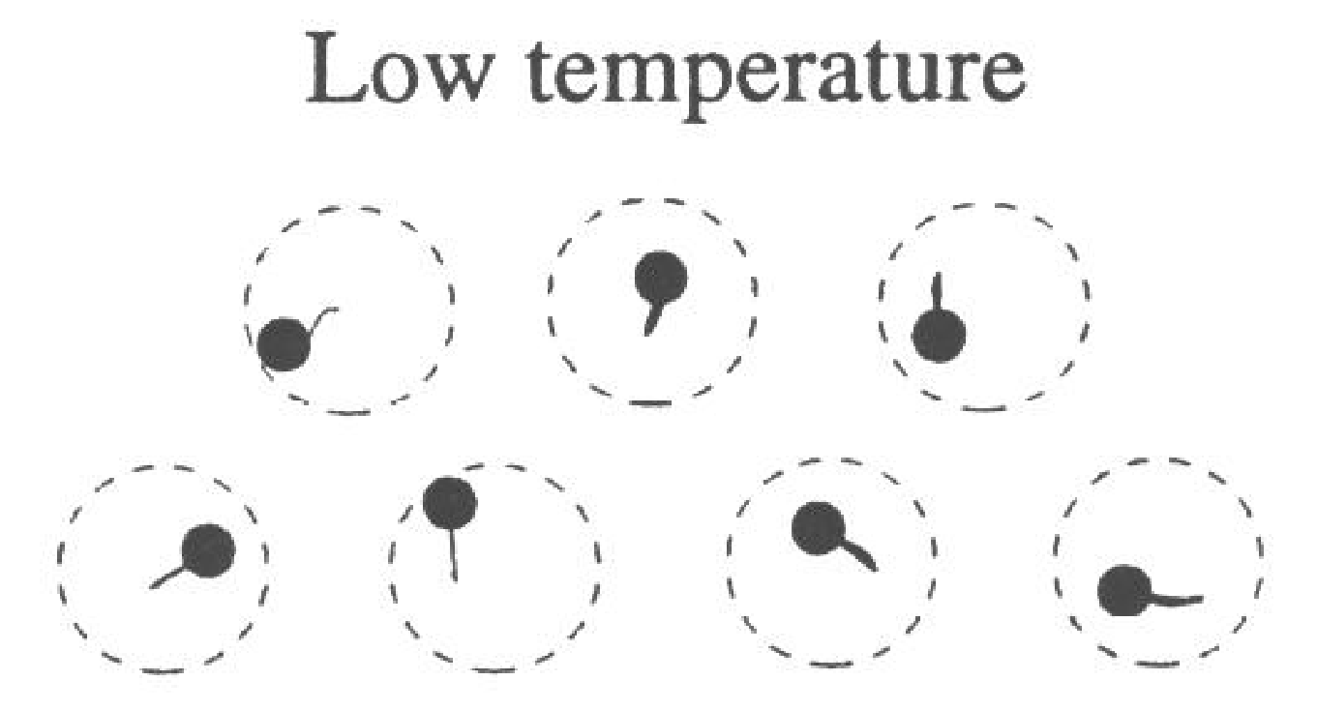
EFFECT OF TEMPERATURE
Air molecules have vibrational dynamic energy which depends ONLY upon
the absolute temperature in degrees Kelvin.
Higher temperature - higher vibrational energy increasing LSS
Lower temperatures - lower vibrational energy reducing LSS

Slide 8
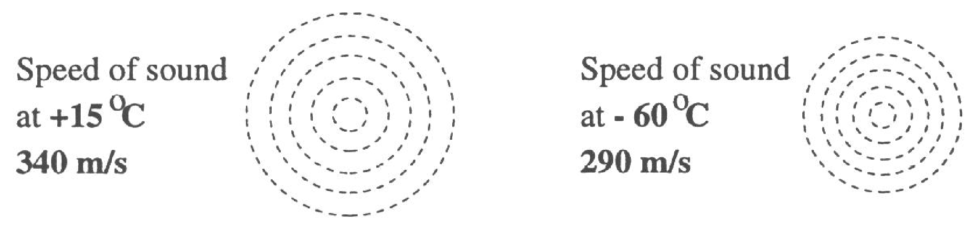
LOCAL SONIC SPEED (knots) = 38.94 X SQUARE ROOT OF THE KELVIN TEMPERATURE
661 KTAS
570 KTAS
Notes:
‹#›

Slide 9
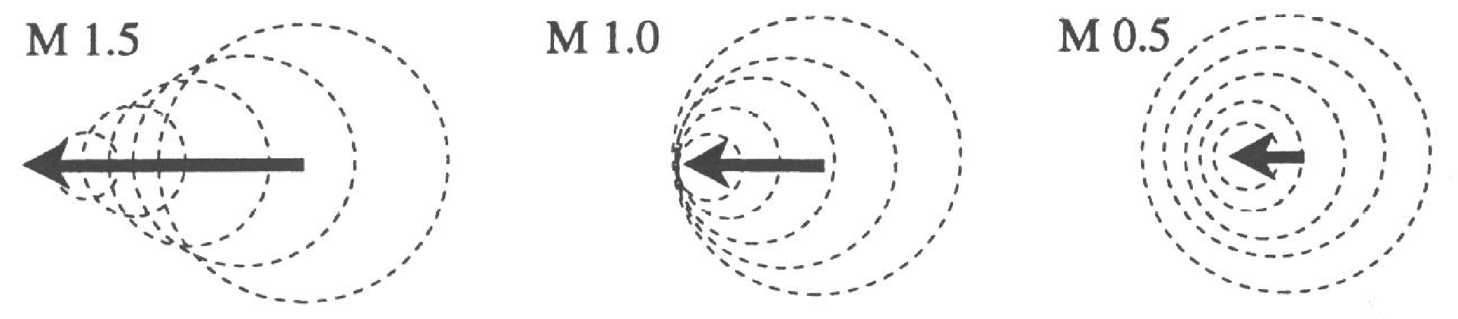
DEFINITION OF MACH NUMBER
Mach 1.5: Aircraft TAS = 150% LSS
Mach 1: Aircraft TAS = 100% LSS
Mach 0.5: Aircraft TAS = 50% LSS
Notes:
‹#›

Slide 10
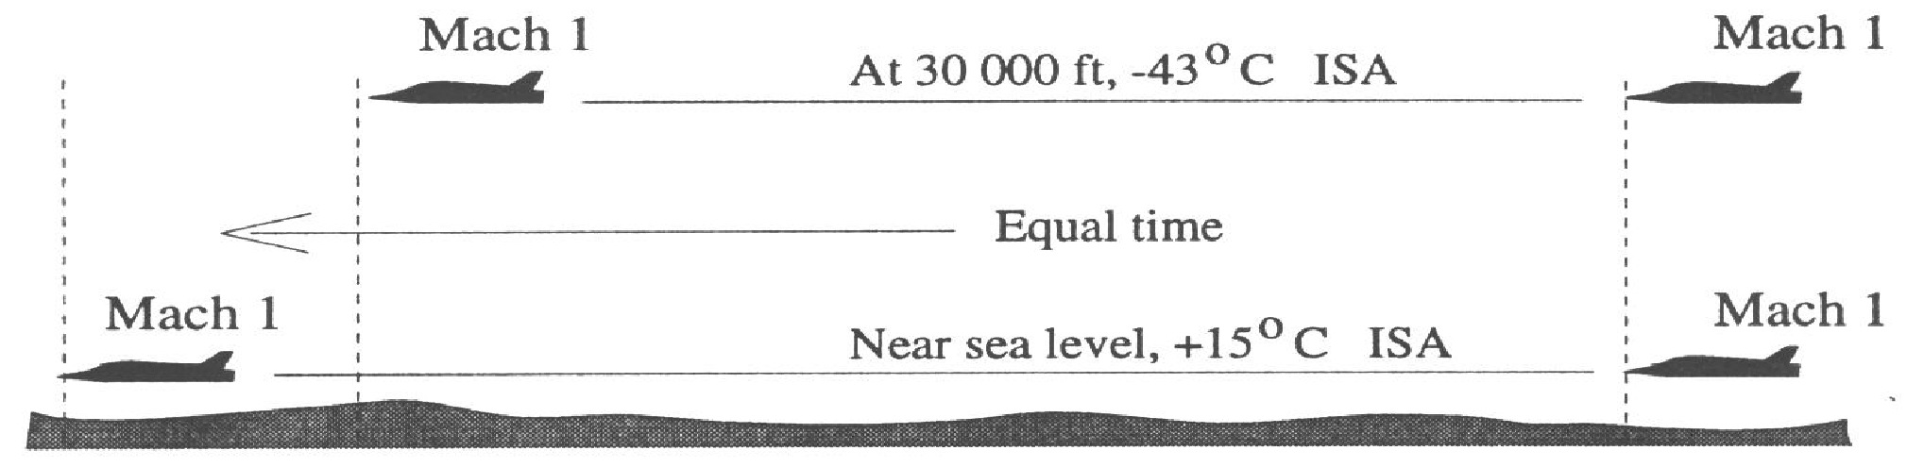
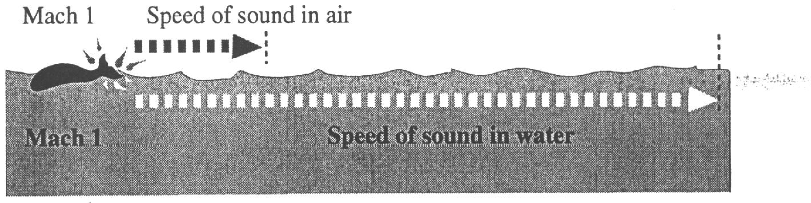
MACH 1 MEANS DIFFERENT SPEEDS AT DIFFERENT ALTITUDES:
AND IN DIFFERENT MEDIUMS – FOR EXAMPLE:
The speed of sound in water is 4.24 times the speed of sound in air.
Notes:
‹#›

Slide 11
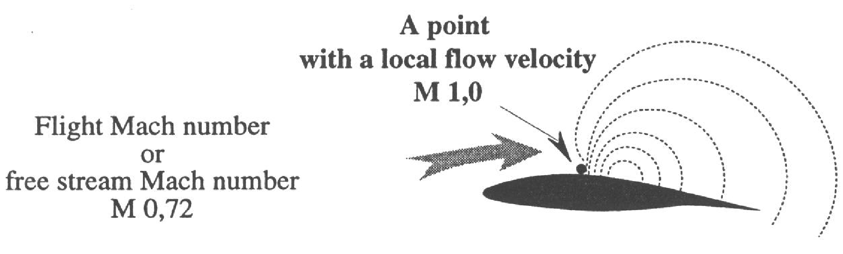
COMPRESSION WAVES
MFS = 0.72
RELATIVE AIRFLOW ACCELERATED OVER AEROFOIL TO MACH 1.0
THEREFORE IN THIS EXAMPLE, CRITICAL MACH NUMBER (Mcrit) = M 0.72
RELATIVE AIRFLOW OFTEN BECOMES SONIC EARLIER (e.g.) OVER COCKPIT
Notes:
‹#›

Slide 12
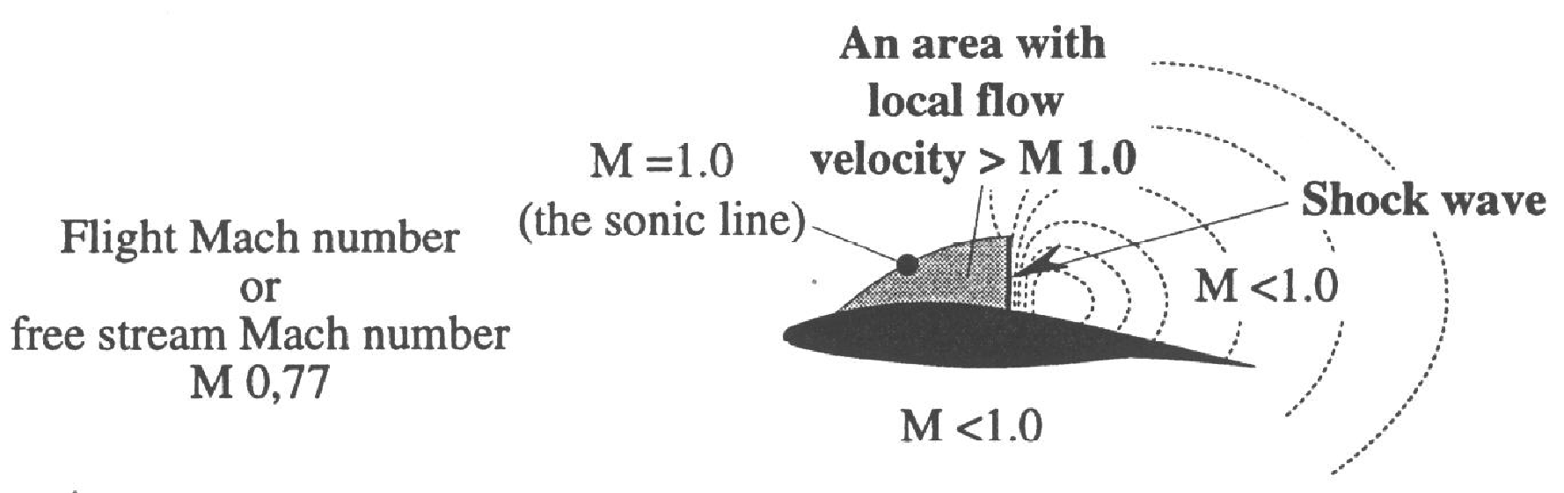
COMPRESSION WAVES
MFS HAS INCREASED TO 0.77
RELATIVE AIRFLOW EXCEEDS MACH 1 INSIDE THE SONIC LINE
SONIC LINE IS THE BOUNDARY BETWEEN SUBSONIC MFS AND SUPERSONIC AIRFLOW (Mach local)
AN EXTREMELY NARROW REGION OF INCREASED DENSITY, PRESSURE AND TEMPERATURE
FORMS AT RIGHT ANGLES TO THE WING –THIS IS CALLED A SHOCKWAVE
AIRFLOW SPEED IS VIOLENTLY REDUCED TO SUBSONIC BY THE SHOCKWAVE
Notes:
‹#›

Slide 13
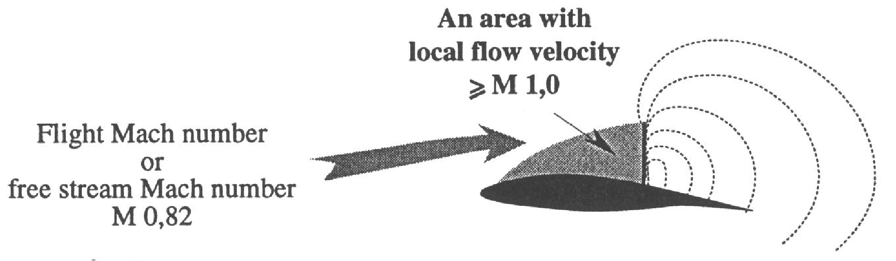
COMPRESSION WAVES
MFS HAS NOW INCREASED IN THIS EXAMPLE TO MACH 0.82
THE AREA OF SUPERSONIC FLOW ABOVE THE WING HAS INCREASED
THE SHOCKWAVE HAS GROWN LARGER, STRONGER AND MOVED REARWARDS
Notes:
‹#›

Slide 14
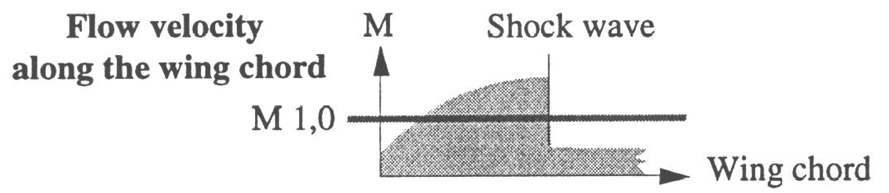
FLOW VELOCITIES
FLOW VELOCITIES CONTINUE TO INCREASE UNTIL REACHING THE SHOCKWAVE
VIOLENT DECELERATION OCCURS AT THE SHOCK
HIGH PRESSURE INSIDE THE SHOCKWAVE CAUSES ADVERSE PRESSURE GRADIENT
Notes:
‹#›

Slide 15
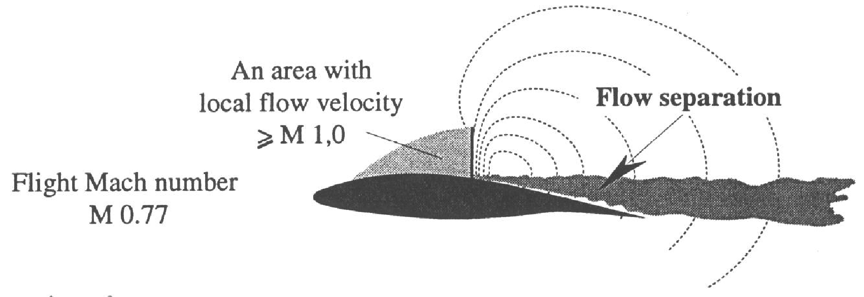
SHOCK INDUCED FLOW SEPARATION
VERY STRONG ADVERSE PRESSURE GRADIENT CAUSES FLOW SEPARATION
THIS LEADS TO A SHARP INCREASE IN DRAG COEFFICIENT AND REDUCTION IN LIFT COEFFICIENT
Notes:
‹#›

Slide 16
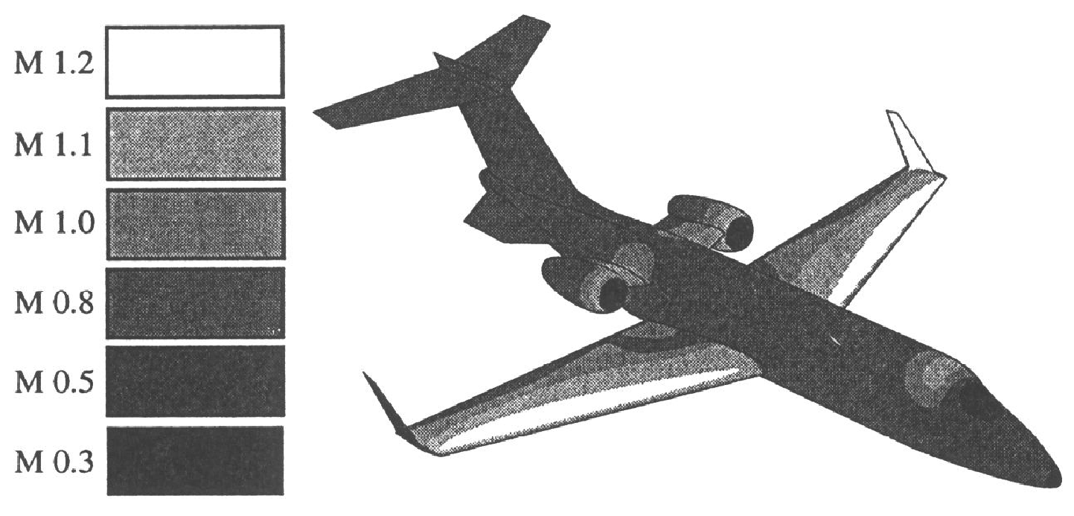
DIVISION OF MACH NUMBERS
SUBSONIC: Mfs AT WHICH ALL SURFACES ARE SURROUNDED ONLY BY SUBSONIC BUT COMPRESSIBLE FLOW
Below M crit
TRANSONIC: Mfs AT WHICH SURFACES ARE SURROUNDED BY A MIX OF SUBSONIC AND SUPERSONIC FLOW
Between M crit and totally supersonic flow ( which is roughly M 1.3)
SUPERSONIC: Mfs AT WHICH ALL SURFACES ARE SURROUNDED BY SUPERSONIC FLOW – (normally above about M 1.3)
Flow is below M 0.3
Notes:
‹#›

Slide 17
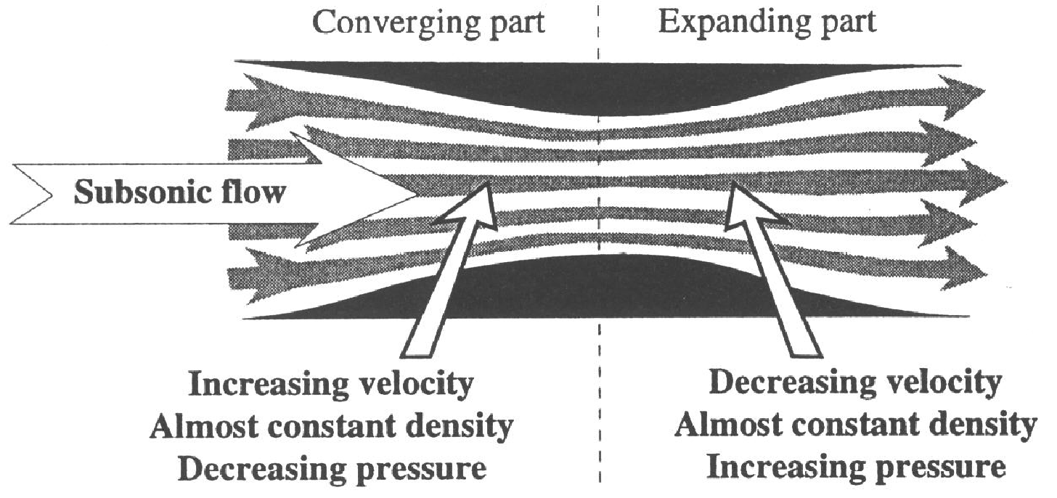
SUBSONIC FLOW IN A DUCT
NORMAL LAWS OF CONTINUITY AND BERNOULLI APPLY
ADVERSE PRESSURE GRADIENT
Notes:
‹#›

Slide 18
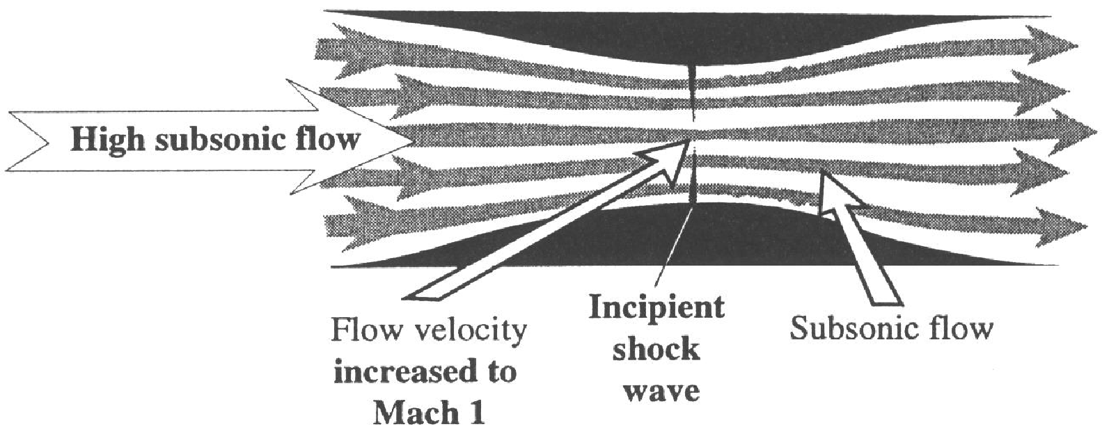
SONIC FLOW IN A DUCT
INCOMING HIGH SPEED SUBSONIC AIRFLOW - AN INCIPIENT BUT RELATIVELY WEAK SHOCKWAVE FORMS AT THE THROAT - THE RESULT OF FLOW ACCELERATION TO MACH 1 IN THE CONVERGENT PART OF THE DUCT.
ADVERSE PRESSURE GRADIENT BEGINS IN THE INCIPIENT SHOCK AT THE THROAT, BUT CAN CONTINUE IN THE DIVERGENT SECTION - THIS LEADS TO TURBULENT FLOW.
ADVERSE PRESSURE GRADIENT
Notes:
‹#›

Slide 19
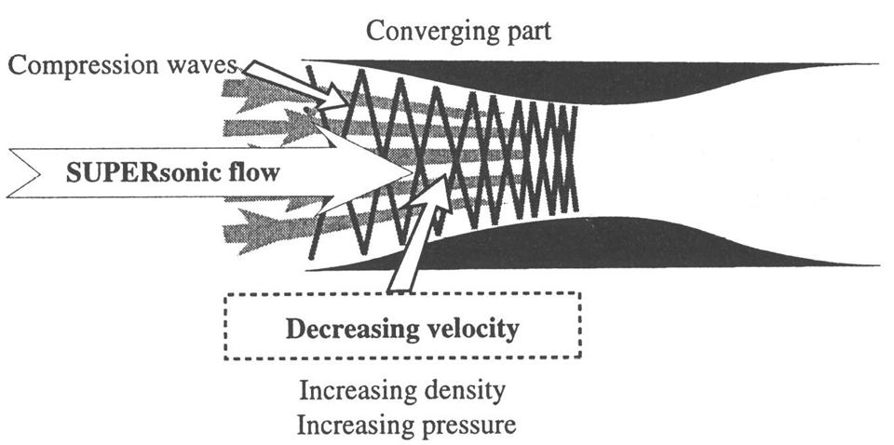
SUPERSONIC FLOW IN A DUCT
IN THE DIAGRAM BELOW, THE FLOW IS SUPERSONIC. BOTH CONVERGENT AND DIVERGENT SECTIONS
OF THE DUCT CREATE DISTURBANCES CALLED MACH WAVES.
IN THE CONVERGENT SECTION OF THE DUCT THE WAVES ARE A SERIES OF WEAK SHOCK WAVES.
THE FLOW VELOCITY IS GRADUALLY REDUCED BY THE SERIES OF SHOCK WAVES; WHILST THE
TEMPERATURE, PRESSURE AND DENSITY ALL INCREASE.
Convergent duct
Divergent Duct

Slide 20
SUPERSONIC FLOW IN A DUCT (cont’d)
JET ENGINE DUCTING IS DESIGNED TO REDUCE INLET FLOW VELOCITY TO SUBSONIC
BEFORE THE FLOW ENTERS THE FIRST COMPRESSOR.
Convergent duct Divergent duct
Notes:
‹#›

Slide 21
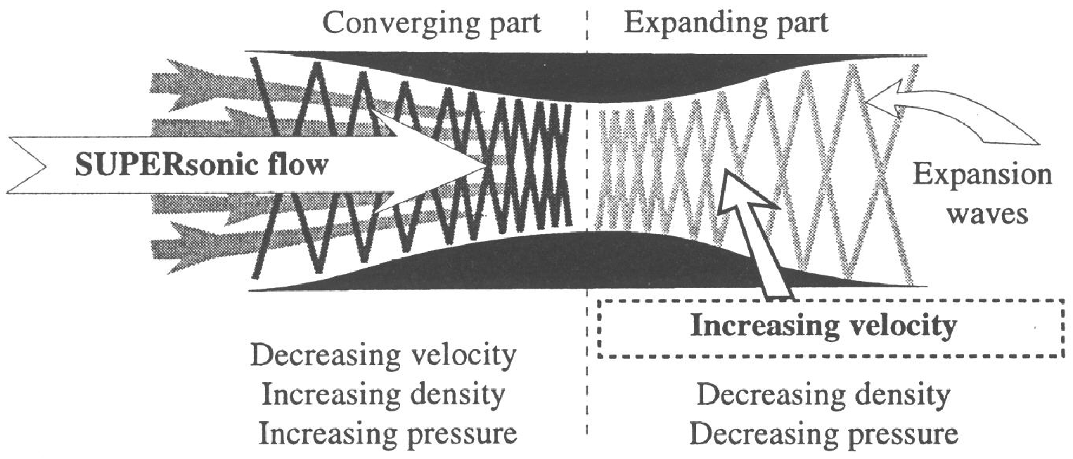
SUPERSONIC FLOW IN A DIVERGENT (De Laval) DUCT (cont’d)
IN THE EXPANDING PART OF A DUCT, SUPERSONIC FLOW ACCELERATES.
DENSITY REDUCES AND VOLUME INCREASES FASTER THAN THE FLOW ACCELERATION – THE DUCT MUST EXPAND TO ACCOMMODATE THE FLOW.
TEMPERATURE REDUCES BECAUSE OF DENSITY AND VOLUME CHANGE – THIS REDUCES SONIC VELOCITY AND INCREASES THE MACH NUMBER OF THE FLOW.

Slide 22
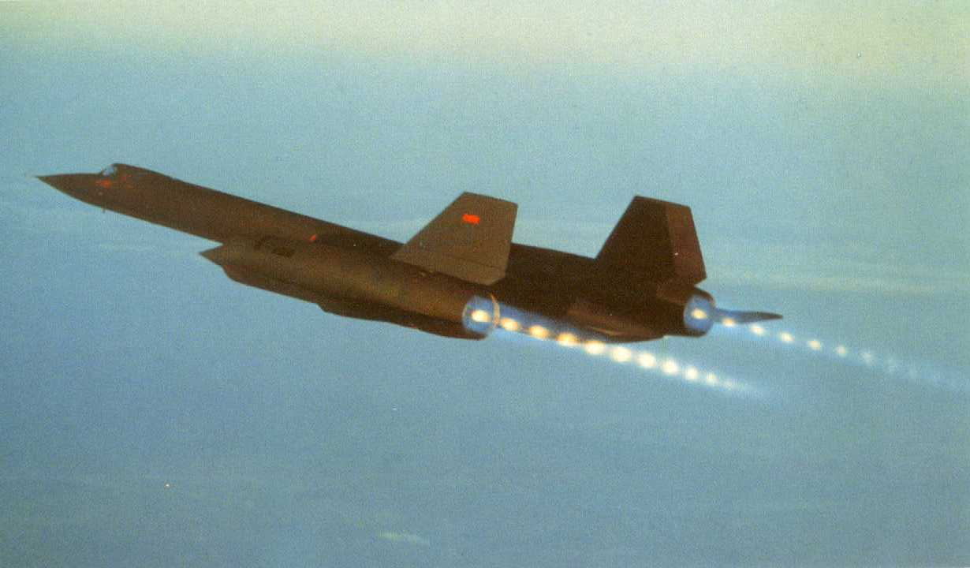
EXPANDING (De Laval) NOZZLE APPLICATION
EXPANSION WAVES IN SUPERSONIC EFFLUX
Notes:
‹#›

Slide 23
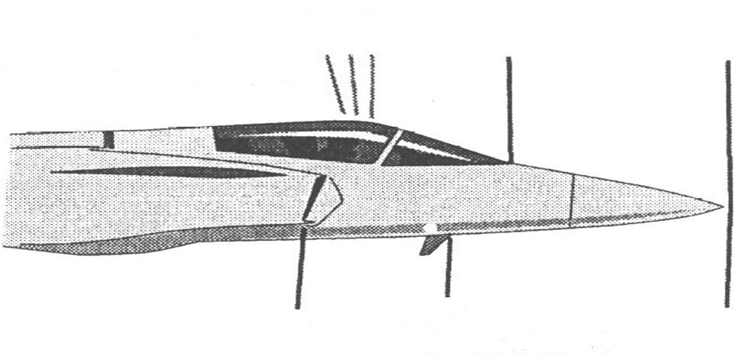
EXTERNAL MACH WAVE FORMATION
THE PHYSICS OF SUPERSONIC FLOW ARE VERY DIFFERENT FROM SUBSONIC FLOW, AND SIMPLER THAN THOSE AT TRANSONIC VELOCITY.
EXTERNAL SUPERSONIC SPEED FLOW IS NOT REDUCED TO SUBSONIC AS OCCURS IN ENGINE INLET DUCTING.
SMALL SHOCK WAVES OCCUR WHEN THERE ARE RESTRICTIONS / CONVERGENCE IN THE THE FLOW.
EXPANSION WAVES OCCUR WHEN THE FLOW BECOMES DIVERGENT AND THE FLOW ACCELERATES. (Prantdl – Meyer expansion)
COMPRESSION IN ANY STAGNATION REGION INCREASES TEMPERATURE, AND THEREFORE SONIC SPEED (EG BEHIND A BOW SHOCK WAVE).
EXPANSION WAVES –
INCREASED FLOW VELOCITY,
VOLUME AND MACH NO.
DECREASED PRESSURE,
TEMPERATURE & DENSITY
BOW SHOCK WAVE
STAGNATION REGION -
INCREASED PRESSURE,
DENSITY, TEMPERATURE.-
THIS CAUSES A LOCAL INCREASE
IN SONIC SPEED
WEAK SHOCK WAVES
.
Notes:
‹#›

Slide 24
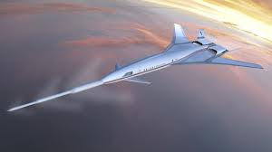
EXTERNAL MACH WAVE FORMATION (cont’d)
LOCALISED TEMPERATURE INCREASE AHEAD OF THE LEADING EDGE INCREASES SONIC SPEED, CAUSING THE BOW SHOCK TO
REMAIN AHEAD OF THE LEADING EDGE UNTIL THE AIRCRAFT ACCELERATES FURTHER AND “CATCHES UP”.
DETACHMENT MACH NUMBER (Mdet) IS THAT VALUE OF MACH FREE STREAM (Mfs) AT WHICH A BOW SHOCK WAVE ATTACHES TO
A LEADING EDGE OF ZERO RADIUS – THIS DEFINES THAT THE AIRCRAFT IS FULLY SUPERSONIC.
ATTACHED BOW SHOCK WAVE

Slide 25
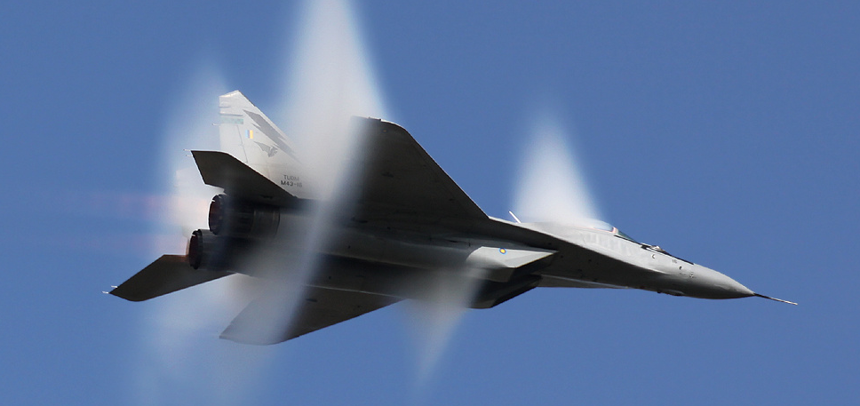
MACH CONE AND SONIC BOOM
SHOCKS WHICH FIRST OCCUR JUST ABOVE Mcrit ARE AT 90 DEGREES TO THE AIRCRAFT SURFACE – FLOW SPEED BEHIND THE SHOCK IS REDUCED TO SUBSONIC.
FURTHER ACCELERATION OF THE AIRCRAFT – SHOCKWAVES BECOME OBLIQUE, AND FLOW BEHIND THEM IS SUPERSONIC BUT DECELERATED AND DEFLECTED.
SONIC BOOM IS CAUSED BY THE CONVERSION OF KINETIC ENERGY INTO SOUND ENERGY, AND IS TRANSMITTED AS PART OF THE SHOCK WAVE AT SONIC SPEED.
AT (SAY) M 1. 4, THE AIRCRAFT IS MOVING 40% FASTER THAN SONIC SPEED, AND HAS LONG PASSED WHEN THE “BOOM” IS HEARD ON THE GROUND.
THE MACH HALF ANGLE IS THE ANGLE BETWEEN THE SHOCKWAVE AND THE LONGITUDINAL AXIS OF THE AIRCRAFT: SINE MACH HALF ANGLE = RECIPROCAL OF
MACH NUMBER. AT MACH 2, SINE MACH HALF ANGLE = 0.5; THEREFORE MACH HALF ANGLE = 30 DEGREES; i.e. THE SHOCKS ARE BECOMING INCREASINGLY OBLIQUE.
THE SHOCK WAVE MOVES ACROSS THE EARTH’S SURFACE AT THE AIRCRAFT GROUND SPEED.
Notes:
‹#›

Slide 26
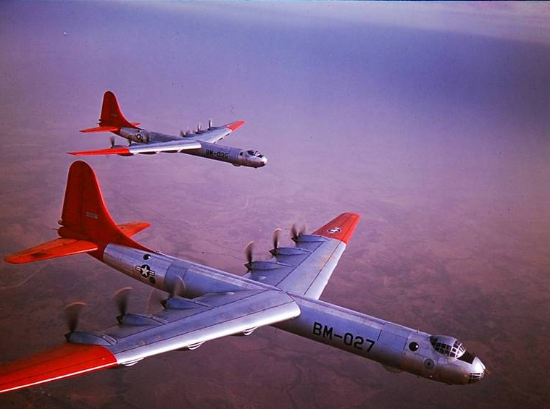
MACH CONE AND SONIC BOOM (cont’d)
The Boeing 36 illustrated was a subsonic aircraft powered by 6 reciprocating power plants driving “pusher” propellers,and 4 turbojet engines - shock formation was undesirable.
The shockwaves would be at right angles to the aircraft surface - the result of subsonic Mach Free Stream but sonic Mach Local (probably initially over the cockpit roof).
Those shocks would have been small, and hopefully the only occurrences of them, because the aircraft type would clearly be unsuited to transonic flight.
A shockwave at right angles to the aircraft surface has subsonic flow behind it.
The Mach Number of this subsonic flow is roughly the reciprocal of that Mach Local just ahead.
An oblique shockwave associated with fully supersonic
flight has supersonic flow ahead, and supersonic but
decelerated flow behind.
There are two velocity components to the decelerated flow
behind a supersonic shock wave:
the vector normal to the shock which is subsonic; and
the vector parallel to the shock which is reduced
supersonic: vector addition produces deflected flow parallel
to the aircraft surface.

Slide 27
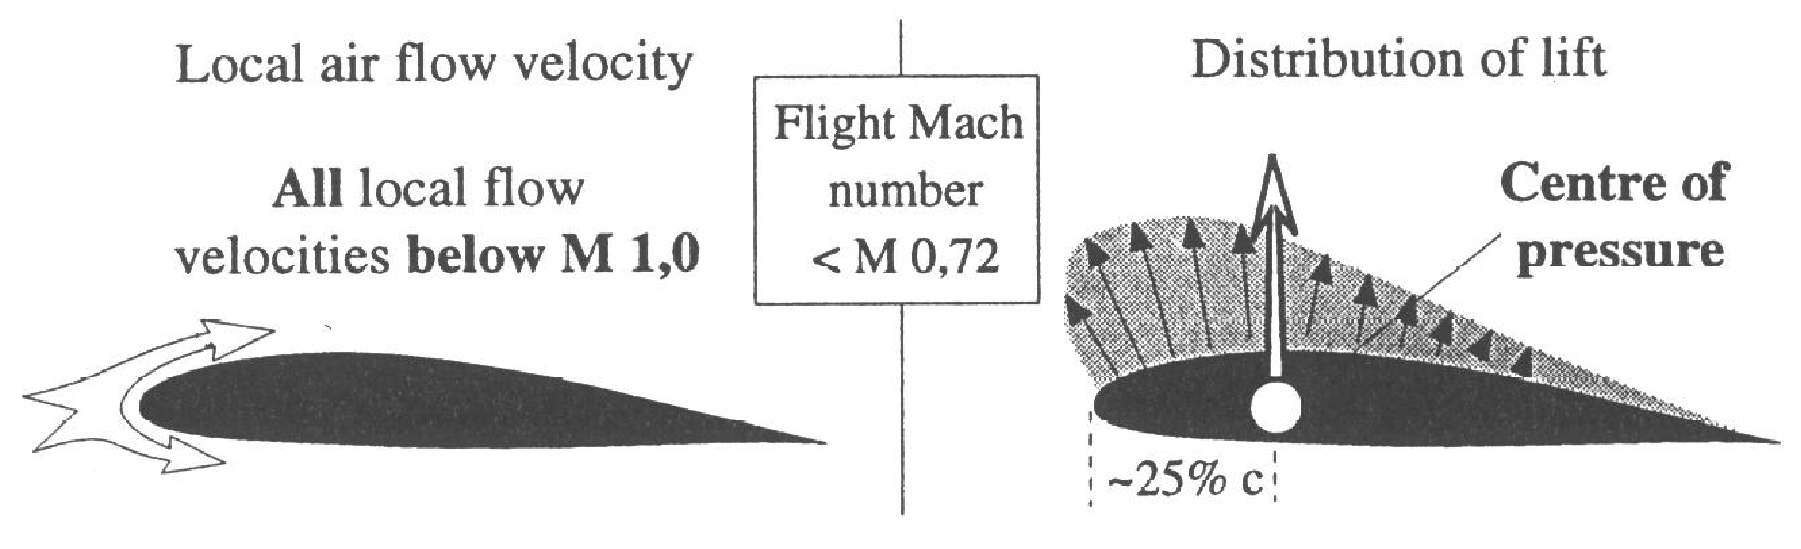
PRESSURE DISTRIBUTION PATTERN IN SUBSONIC FLOW
THE DIAGRAM ILLUSTRATES A TYPICAL PRESSURE PATTERN AT SUBSONIC SPEEDS.
COMPRESSIBILITY ISSUES INCREASE AS MACH NUMBER / EAS INCREASES.
Notes:
‹#›

Slide 28
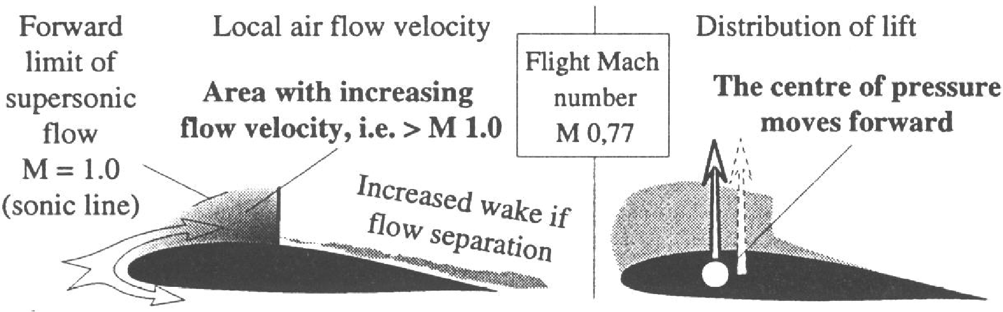
PRESSURE DISTRIBUTION PATTERN IN TRANSONIC FLOW
CRITICAL MACH NUMBER (Mcrit) IS DEFINED AS THAT FREE STREAM MACH NUMBER AT WHICH RELATIVE
AIRFLOW REACHES A LOCAL FLOW VELOCITY OF MACH 1 OVER ANY PART OF THE AIRCRAFT. (The diagram
below indicates this occurring at MFS of less than M 0.77).
CONTINUED ACCELERATION LEADS TO SHOCK WAVE FORMATION.
ADVERSE PRESSURE GRADIENT IN THE INITIAL SHOCK WAVE CAUSES THICKENED BOUNDARY
LAYER, THEN FLOW SEPARATION AS THE SHOCK WAVE STRENGTHENS.
AS A RESULT THE CENTRE OF PRESSURE MOVES FORWARD, AND MAY CAUSE AN INITIAL NOSE UP PITCH.
Notes:
‹#›

Slide 29
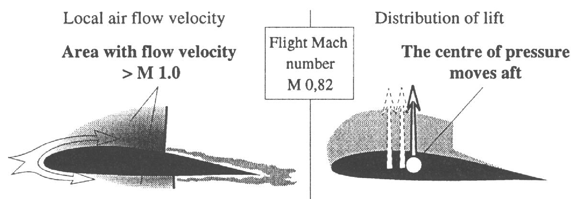
PRESSURE DISTRIBUTION PATTERN IN TRANSONIC FLOW (cont)
THE DIAGRAM BELOW ILLUSTRATES ACCELERATION TO MFS OF M 0.82 .
SUPERSONIC AIR FLOW AREA HAS ENLARGED REARWARDS.
THE SHOCK WAVE HAS GROWN STRONGER, MOVED REARWARDS, AND A SHOCKWAVE IS
BEGINNING TO FORM ON THE WING UNDERSURFACE.
REARWARD MOVEMENT OF THE SHOCK WAVE AND INCREASED AREA OF SUPERSONIC FLOW OVER THE WING CAUSES THE CENTRE OF PRESSURE TO MOVE REARWARDS.
THIS LEADS TO A NOSE DOWN PITCHING MOMENT CALLED MACH TUCK: controlled by a MACH TRIMMER.

Slide 30
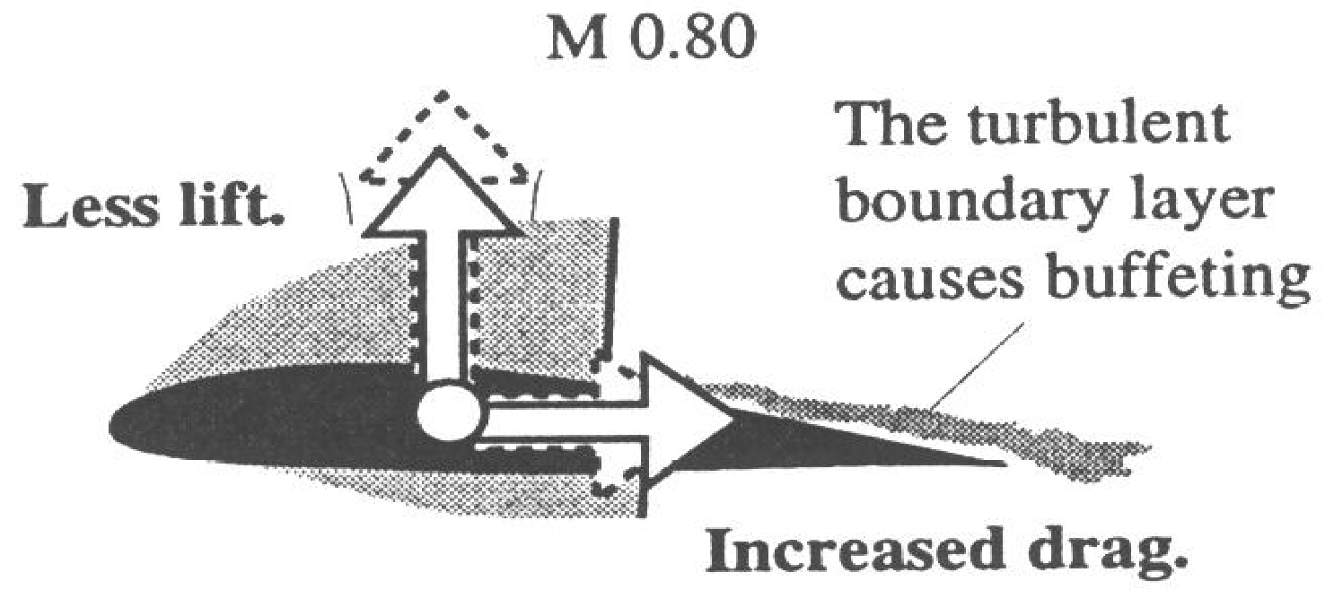
TRANSONIC BUFFETING AND SHOCK STALL
SHOCKWAVES cause ADVERSE PRESSURE GRADIENT leading to FLOW SEPARATION.
This causes a sharp DECREASE IN LIFT COEFFICIENT and rapid INCREASE IN DRAG COEFFICIENT.
TRANSONIC BUFFETING and SHOCK STALL is associated with flow separation behind the shock wave.
MACH CRITICAL DRAG RISE (Mcdr) is defined as that value of Mfs at which the constant low value of
drag coefficient increases by 20%. Mcdr is usually 5% - 10% higher than Mcrit.
Notes:
‹#›

Slide 31
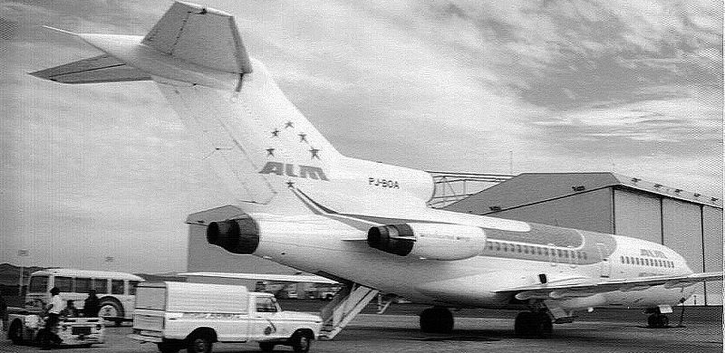
SHOCK STALLS (cont’d) / EFFECTS ON CONTROL SURFACES
Shock stalls have similar symptoms to stalls in low speed aircraft, but occur at high speed / low angle of attack; and have a higher buffet frequency: assymetric wing flow separation may also cause roll.
Rapid and different movements of upper and lower shock waves and flow separation can occur. This may cause: control surface vibration; undesired deflections and hinge moments; loss of control surface efficiency.
Variable incidence stabilisers / full flying tailplanes, and other low speed / high speed devices can assist.
Full flying tail

Slide 32
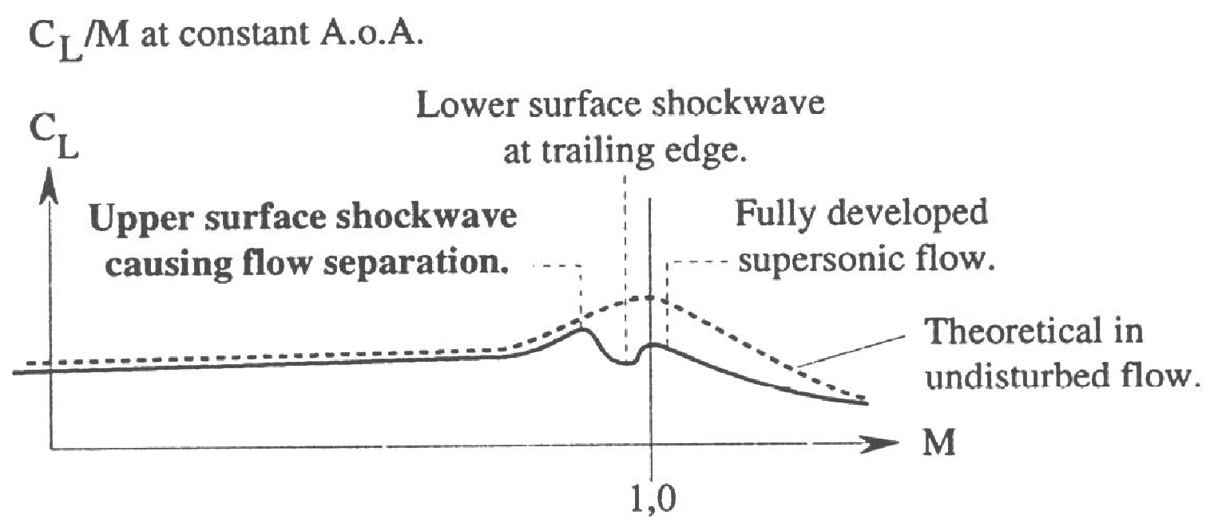
EFFECT OF SHOCK WAVES ON LIFT COEFFICIENT
At a constant angle of attack, lift coefficient remains almost constant at subsonic speeds; but increases slightly as the aircraft
approaches Mcrit – (caused by sharper up wash as the relative airflow approaches the stagnation region at the leading edge).
Shock wave formation above Mcrit causes flow separation, leading to a sharp reduction in lift coefficient.
Provided the aircraft is designed for supersonic flight, the shock waves on both upper and lower wing surfaces eventually
reach the wing trailing edge – this allows the coefficient of lift to recover, at least temporarily.
The physics of supersonic flow are very different to those of subsonic, and lift coefficient reduces again as Mach no. increases.
Notes:
‹#›

Slide 33
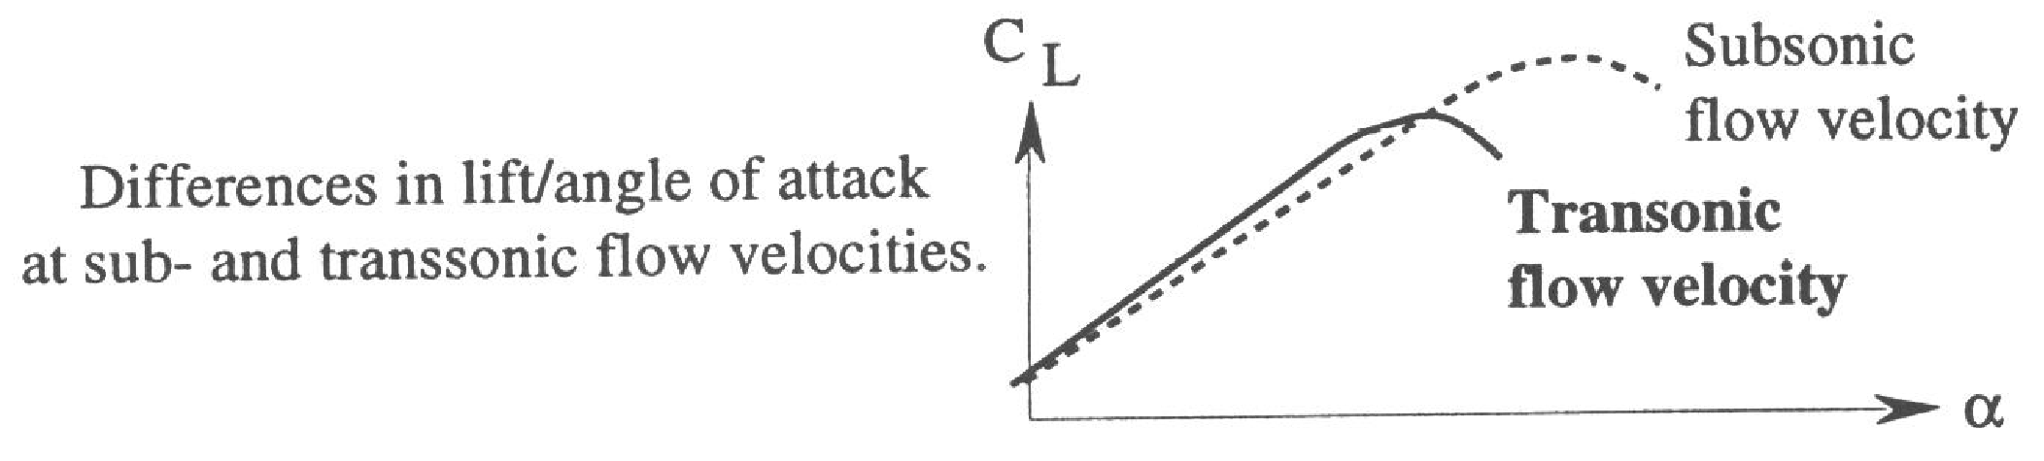
EFFECT OF HIGH MACH ON CL max
For a given EAS, increasing angle of attack increases acceleration of relative airflow over
the wing, thus increasing local Mach number at the point of maximum camber.
At high Mach number this acceleration can cause the flow to become sonic at angles of attack
signifigantly less than the normal stalling angle.
The symptoms of the inevitable shock wave include flow separation and all other problems
associated with supersonic flow in a high speed subsonic aircraft.
At higher subsonic Mach numbers the maximum angle of attack and therefore CL max are both
lower than at slower Mach numbers.
This affects the flight envelope in which the aircraft can operate.
transonic
Notes:
‹#›

Slide 34
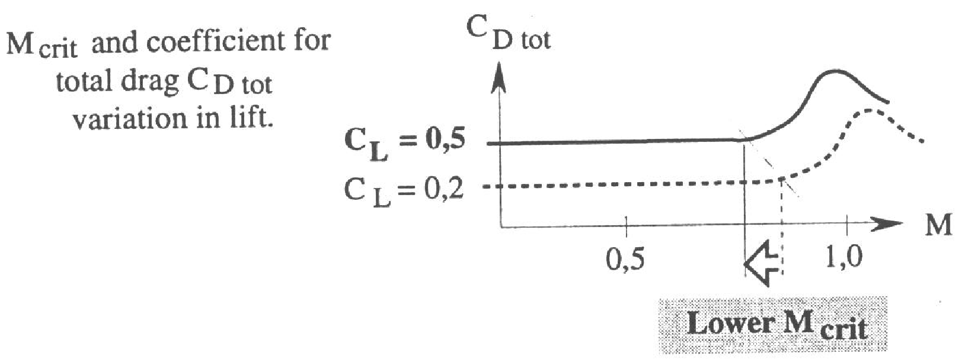
EFFECT OF INCREASED WING LOADING OR LOAD FACTOR ON Mcrit
For a given EAS / Mach number, an increase in aircraft mass requires an increase in lift
coefficient, and therefore an increase in angle of attack.
Greater acceleration over the upper wing surface means earlier sonic flow and
therefore lower Mcrit.
An increase in load factor caused by (for example) a steep level turn also requires higher lift
coefficient and angle of attack: therefore greater relative airflow acceleration and lower Mcrit.

Slide 35
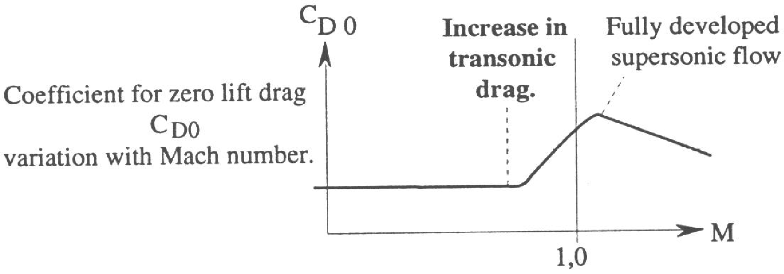
EFFECT OF SUPERSONIC FLOW ON DRAG COEFFICIENT
A shock wave causes a temperature increase within the shock itself (adiabatic compression),
thus consuming energy in the form of additional zero lift drag called WAVE DRAG (Dm).
Flow separation also causes an increase in drag coefficient as a result of boundary layer
thickening, then turbulent flow.
Flow separation and wave drag cause a steep rise in drag coefficient at Mcdr, which
occurs 5%-10% higher than Mcrit.
Drag coefficient reduces again if the aircraft can accelerate to fully supersonic.

Slide 36
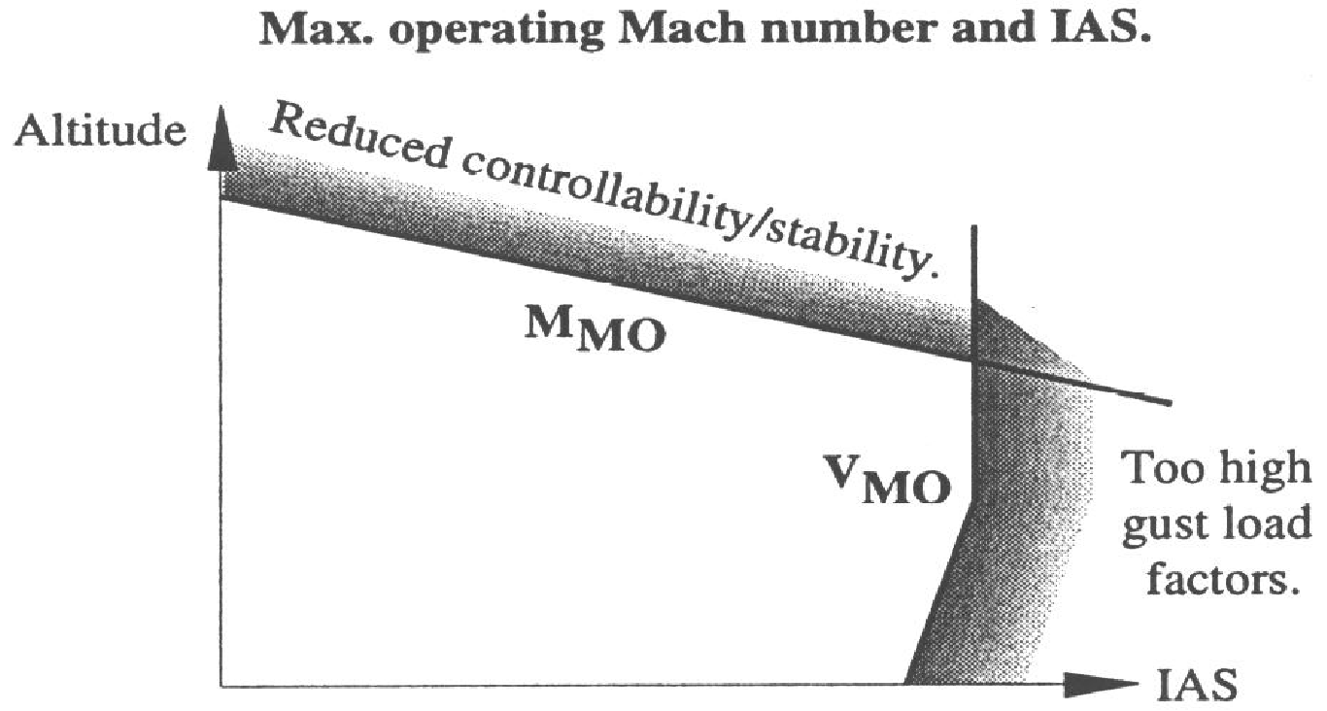
MACH MAX OPERATION (M_{MO) /} VELOCITY MAX OPERATION V_{MO}
Vmo represents max. IAS in the lower altitude range – slight increase with climb due IAS/CAS to EAS correction.
For constant EAS, TAS increases with altitude and Mach number increases faster because temperature reduces.
TAS AND MACH INCREASE WHEN CLIMBING AT CONSTANT IAS BELOW Vmo. Mmo CAN BE EXCEEDED!

Slide 37
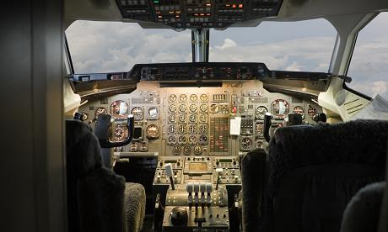
MACH MAX OPERATION (M_{MO) /} VELOCITY MAX OPERATION V_{MO (cont’d)}
Conversely, for an aircraft descending at constant Mach, TAS increases because sonic speed increases with temperature: as density correction reduces, EAS increases at an even faster rate.
Vmo (IAS) CAN BE EXCEEDED WHILE DESCENDING BELOW Mmo.
Transition from IAS to Mach number and vice versa while climbing descending occurs at FL 230 to FL250.

Slide 38
PRINCIPLES OFJET AIRCRAFT PERFORMANCE – ANGLE OF CLIMB
Best angle of climb { T = D +(W × Sine Climb Angle) } occurs when excess thrust compared to drag is maximum.
Minimum drag and therefore maximum excess thrust occurs when the aircraft is aerodynamically totally “cleaned up”.
Increased mass increases VIMD and total drag, thus reducing the excess thrust as illustrated.
Increased altitude reduces engine thrust output, reducing the excess thrust and angle of climb.
TOTAL DRAG
TURBOFAN THRUST AVAILABLE
Reduced Angle of Climb
INCREASED TOTAL DRAG AT HIGHER MASS
Max Angle of Climb (Vx)
THRUST REQUIRED (TOTAL DRAG) AT A GIVEN MASS
Increased Vx
VIMD (Vx)
EQUIVALENT AIRSPEED (EAS)

Slide 39
PRINCIPLES OFJET AIRCRAFT PERFORMANCE - RANGE
Specific Air Range (SAR expressed air nautical miles per litre) = TAS (anm per hour) ÷ Fuel Flow (litres per hour).
Specific Fuel Consumption (SFC expressed as litres per hour per kg thrust) = fuel flow (L / hr) ÷ thrust (kgs) fuel flow = SFC × Thrust:
Therefore SAR = TAS × {1 ÷ (SFC ×Thrust)}; and SAR ={ (TAS÷Thrust) ×(1÷SFC) }:
In level flight ; Thrust = Drag, thus SAR = { (TAS÷Drag) ×(1÷SFC) }.
The MAXIMUM SAR is therefore obtained using minimum value of (Drag÷TAS) which is 1.32 VIMD.
The flight level selected is that which gives design RPM (thus minimum SFC) at the appropriate TAS ( high but do not exceed design RPM ).
The principles of headwind and tailwind operation are the same as those for lower speed operations (Specific Ground Range – gnm per 1000 L / KG).
TOTAL DRAG
Note:The correction from IAS or
EAS to TAS is linear.
1.32 VIMD
TAILWIND / HEADWIND
TAS

Slide 40
PRINCIPLES OFJET AIRCRAFT PERFORMANCE - ENDURANCE
FUEL FLOW NEEDS TO BE REDUCED TO THE MINIMUM CONSISTENT WITH SPEED STABLE LEVEL FLIGHT. WIND IS OF NO RELEVANCE
Fuel flow is minimum when engine thrust required for level flight is minimum. Thrust = drag in level flight.
Vimd or slightly higher for speed stability at the flight level which achieves design engine RPM which generally a slightly higher level than 1.32 Vimd.
A chart for DRAG / TAS may be available and the corresponding Mach number can easily be calculated if not available on the chart.
IAS EAS is a compressibility correction. The relationship EAS / TAS = √ Altitude Density / √Sea Level Density. EAS TAS drag curve right.
TOTAL DRAG
TURBOFAN THRUST AVAILABLE
INCREASED TOTAL DRAG AT HIGHER MASS
THRUST REQUIRED (TOTAL DRAG) AT A GIVEN MASS
Increased Vimd
Vimd
EQUIVALENT AIRSPEED (EAS)

Slide 41
PRINCIPLES OFJET AIRCRAFT PERFORMANCE – RATE OF CLIMB
Power required curves for any mass or altitude are derived from the corresponding drag curves illustrated in slides 38 - 40.
Power Required is proportional to Drag × TAS, and is therefore proportional to the cube of TAS – hence the curve is a little steeper than the drag curve.
Power Available is a simple linear graph, unlike a turboprop or piston engine – the notion of power is relatively recent in jets,
and is related to the high bypass ratios and rotary nature of turbofans.
In the graph illustrated, there is speed range where the excess power available curve for maximum rate of climb is parallel to the power available curve.
A turbofan aircraft therefore has a range of available speeds for maxmum rate of climb, and can therefore keep a constant attitude in a climbing turn.
POWER
TURBOFAN POWER AVAILABLE
Power Available / Power Required
parallel in the speed range indicated.
POWER REQUIRED FOR S & L
Speed Range For Max Rate of Climb
Region of reverse
command
VMP
VELOCITY

Slide 42
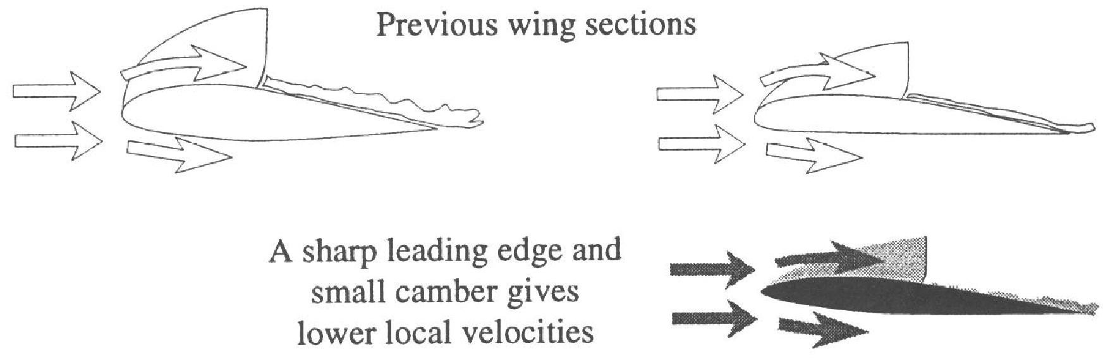
HOW TO INCREASE CRITICAL MACH NUMBER
(1) WING SECTION: (2) WING SWEEP: (3) VORTEX GENERATORS.
SONIC FLOW OVER THE UPPER WING IS CAUSED BY ACCELERATION OF RELATIVE AIRFLOW: THIS IS ACCENTUATED OVER A ROUNDED LEADING EDGE, AND / OR THICK HIGH LIFT AEROFOIL SECTION.
ONE SOLUTION IS TO USE A THIN AEROFOIL SECTION WITH A SHARP LEADING EDGE – THERE ARE, HOWEVER, ISSUES WITH STRUCTURAL STRENGTH, FUEL STORAGE AND WING BENDING RELIEF.

Slide 43
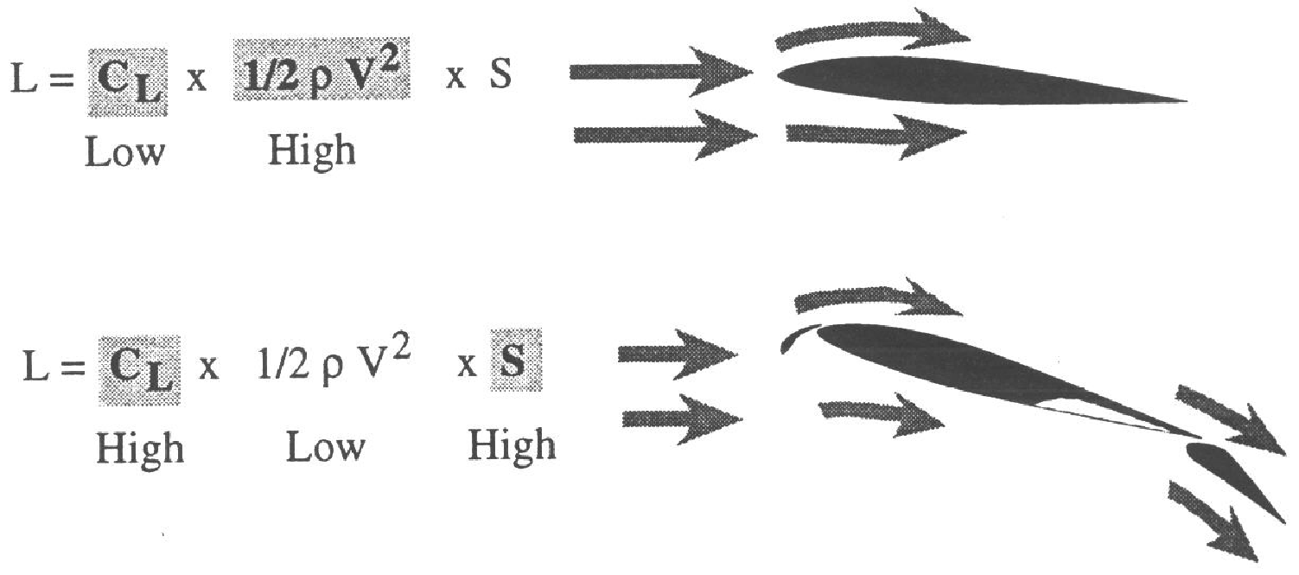
HIGH SPEED WINGS AT LOW SPEED
DURING CRUISING FLIGHT, THE HIGH SPEED AND THEREFORE HIGH DYNAMIC PRESSURE MEANS THAT
LOW LIFT COEFFICIENT (IN THIS EXAMPLE CAUSED BY A THIN WING AND SHARP LEADING EDGE), IS OK.
AT LOW SPEEDS SUCH AS INITIAL CLIMB AFTER TAKE OFF, OR ON FINAL APPROACH; THE LOW LIFT
COEFFICIENT REQUIRES EITHER A HIGH WING AREA AND / OR VERY EFFECTIVE HIGH LIFT DEVICES.
Notes:
‹#›

Slide 44
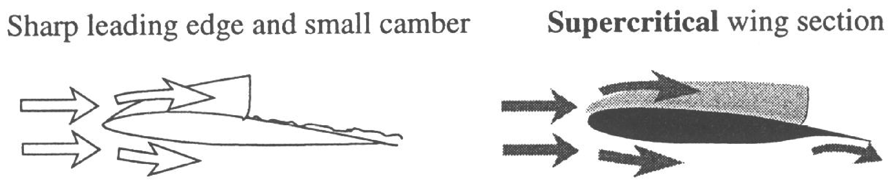
SUPERCRITICAL WING SECTIONS
A very evolved modern wing design which gives a range of minimum drag speed availability and lower drag.
Maximum thickness at roughly 50% chord, associated with a relatively flat upper surface – delayed airflow
acceleration and more symmetrical lift distribution over the wing cross section.
Reflex camber on underside at rear assists lift coefficient and enhances symmetrical lift distribution by
creating lift on underside of rear wing section – this assists further in delaying airflow acceleration on top.
A thicker aerofoil , rounded leading edge, improved monocoque structural strength and wing fuel storage are
then accommodated, while employing a lower sweepback angle but achieving higher critical mach number.
Reflex camber (can
aggravate mach tuck)

Slide 45
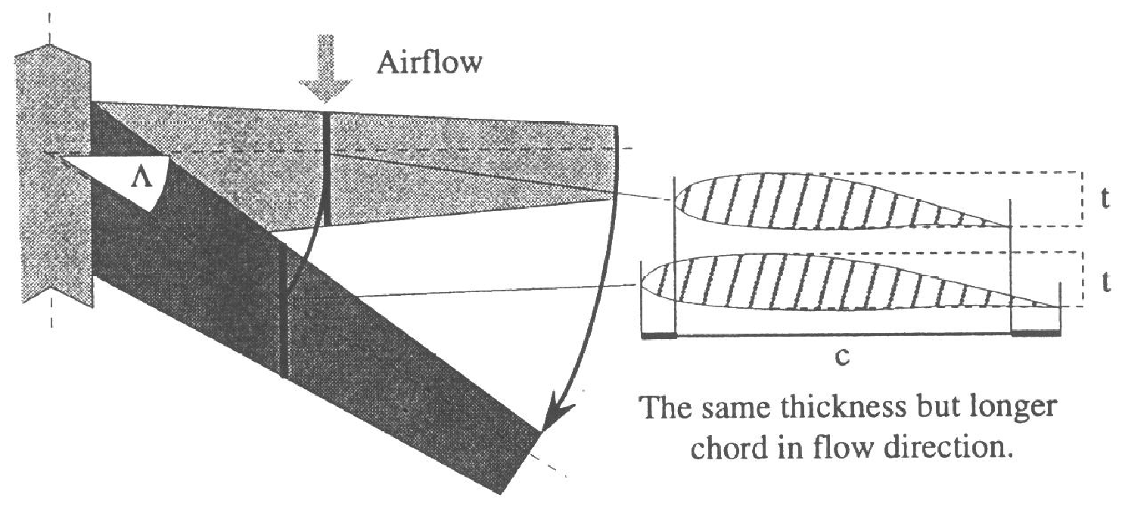
INCREASING CRITICAL MACH NUMBER BY USING SWEEPBACK
The diagram below illustrates how the use of sweepback decreases the thickness / chord ratio by increasing
the apparent length of chord parallel to the longitudinal axis at any given wing cross section – the wing
thickness at that same given cross section remains unchanged.
This means that the wing retains monocoque strength and fuel capacity for wing bending relief.
A crescent wing employs higher sweepback at the wing root, thus retaining extra strength at the wing root.
Notes:
‹#›

Slide 46
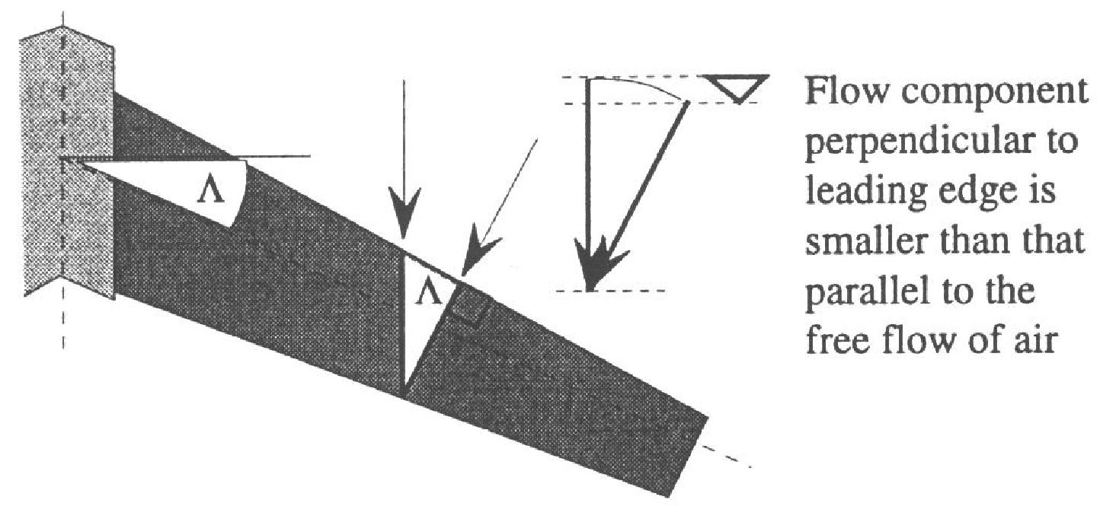
INCREASING CRITICAL MACH NUMBER BY USING SWEEPBACK (cont’d)
Sweepback divides the free stream relative airflow velocity vector parallel to the longitudinal axis into two components –
one at right angles to the leading edge and the other parallel to the leading edge. The velocity at right angles to the leading edge
is a function of the cosine of the angle of sweepback, and is thus lower than Mfs.
Sweepback thus increases Mcrit, but creates problems of its own.
The flow velocity parallel to the leading edge is problematic regarding induced drag, early wing tip stall, and dutch roll.
Use of supercritical wing sections can reduce sweepback angle and mitigate these problems.
Notes:
‹#›

Slide 47
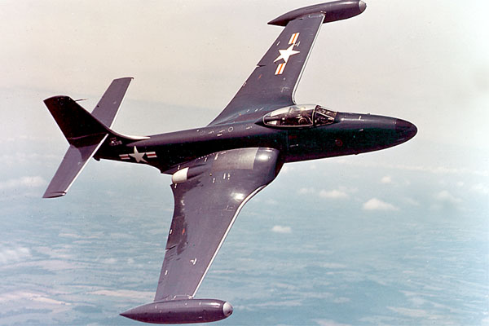
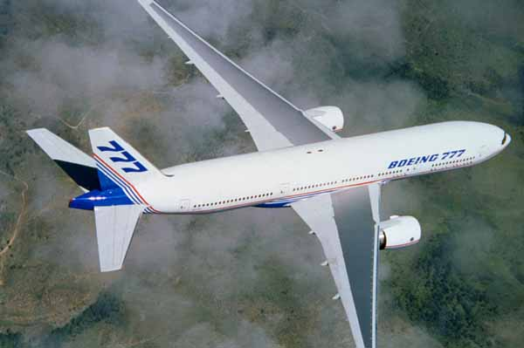
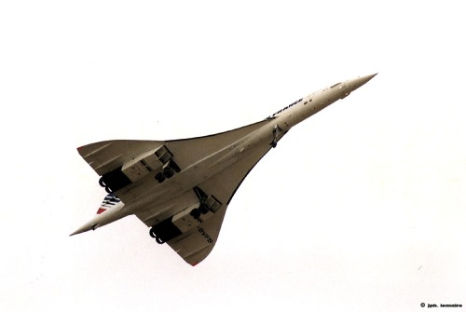
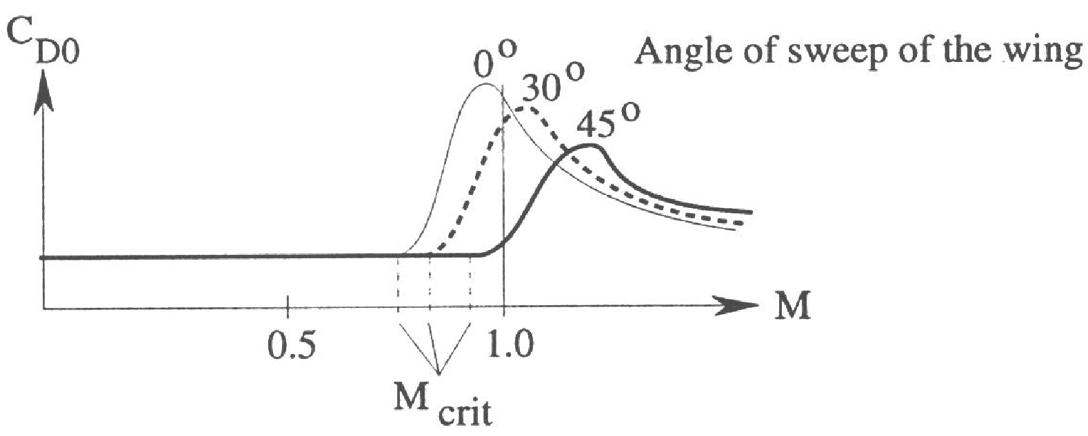
INCREASING CRITICAL MACH NUMBER BY USING SWEEPBACK (cont’d)
Flow velocity normal to the wing leading edge decreases with increased sweepback angle This increases Mcrit as shown below.
M_{crit} 0.7
M_{crit} 0.85
M_{crit} 0.98
Mach Critical Drag Rise (Mcdr) is 5% - 10% higher than Mcrit

Slide 48
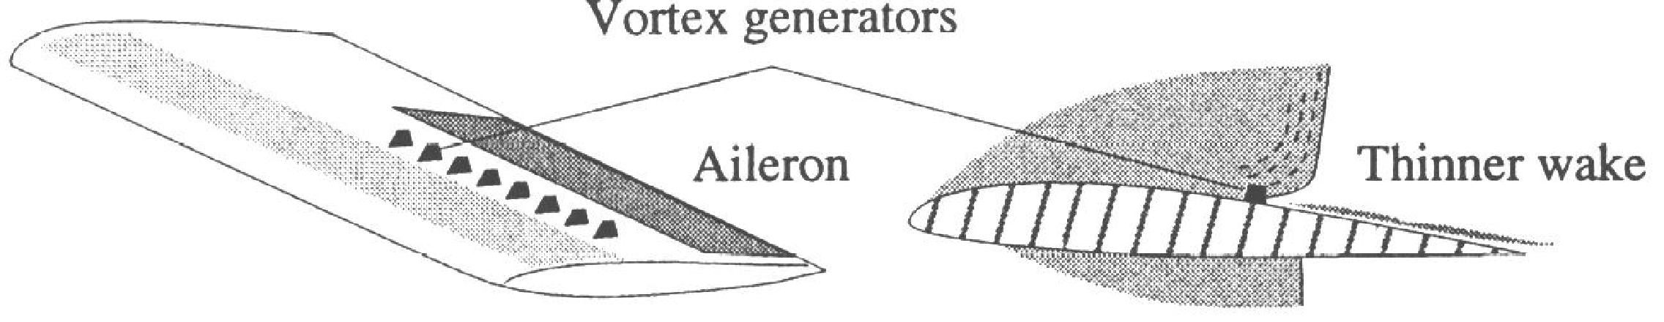
HOW TO INCREASE CRITICAL MACH NUMBER – VORTEX GENERATORS
Vortex generators are used extensively in aircraft design, even in very light low speed aircraft. The principle is
to RE - ENERGISE BOUNDARY LAYER by mixing that de energised layer close to the wing surface with that
more fully energised flow from the region further away from the wing. This produces a thicker, more turbulent but attached airflow, re energised to exceed adverse pressure gradient. Skin friction increases, but delayed flow separation reduces form drag. Indentations in golf balls and elite competitive swimsuits are every day examples.
They are often used at the wingtips on swept wing aircraft to mitigate against the problem of wingtip stalling.
Flow separation as a result of “steep” adverse pressure gradient at a shock wave creates turbulence, buffeting,
loss of lift coefficient, and a sharp increase in drag coefficient - vortex generators mitigate this problem by delaying flow separation.
Vortex generators create shock waves individually, but these shock waves are small and of little consequence.

Slide 49
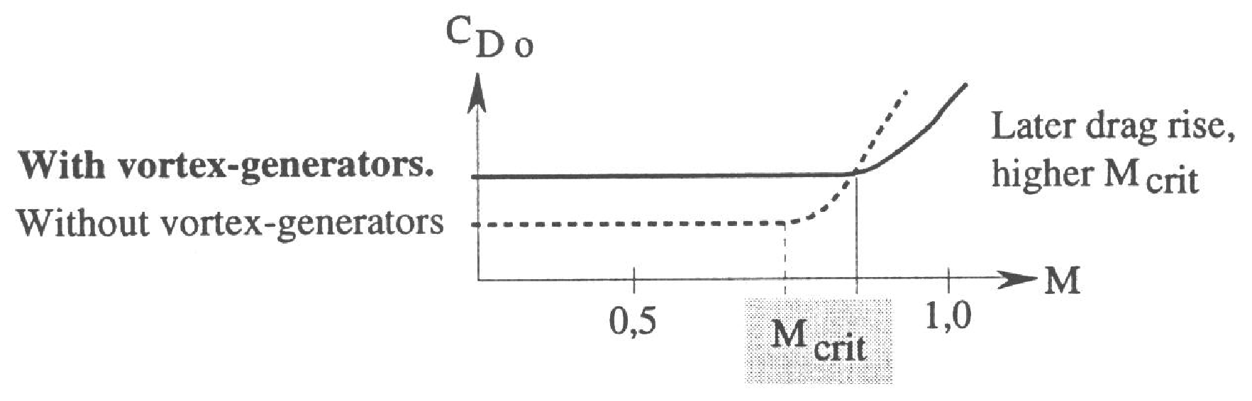
HOW TO INCREASE CRITICAL MACH NUMBER – VORTEX GENERATORS (cont’d)
Shock waves (including those small shocks associated with the vortex generators)
thus develop over a longer chord and delay flow separation.
The effect is to increase subsonic drag but reduce transonic drag.

Slide 50

SUMMARY
ANY COMBINATION OF THE DESIGNS PREVIOUSLY DISCUSSED AND SUMMARISED BELOW CAN BE USED TO INCREASE Mcrit.

Slide 51

PRINCIPLES OF AIRCRAFT PERFORMANCE – RATE OF CLIMB

